Slide 1


Flipkart Logistics Optimization for Delivery Routes SUDIKSHA ASLESHA

Slide 2
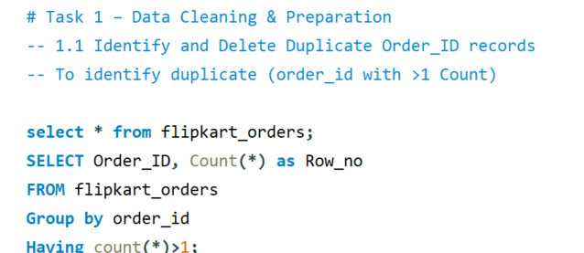
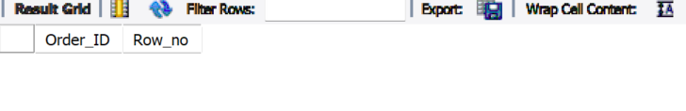
Task 1: Data Cleaning & Preparation

Slide 3
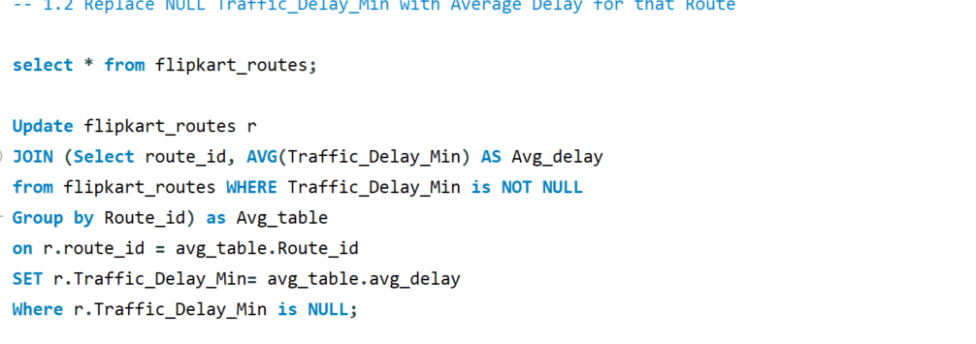
1.2: Replace NULL Traffic_Delay_Min with Average Delay for that Route

Slide 4
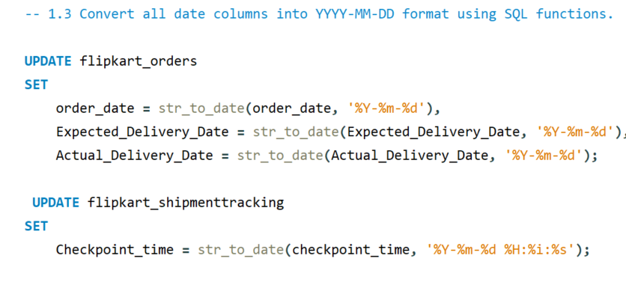
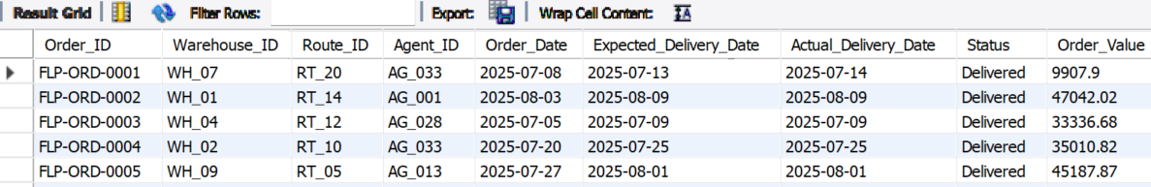
1.3: Convert all date columns into YYYY-MM-DD format using SQL functions.

Slide 5
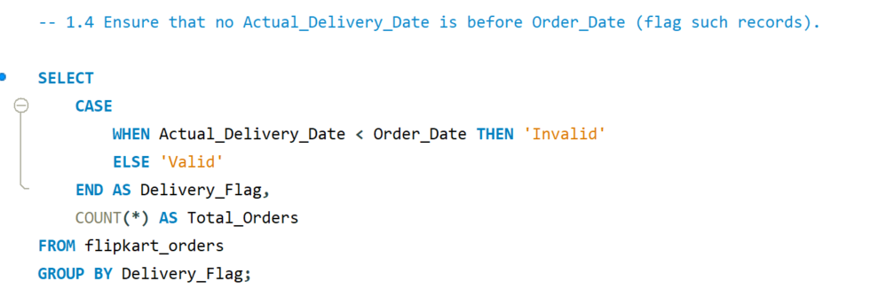
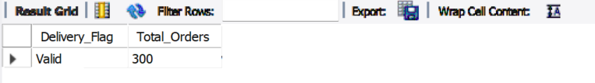
1.4: Ensure that no Actual_Delivery_Date is before Order_Date (flag such records).

Slide 6
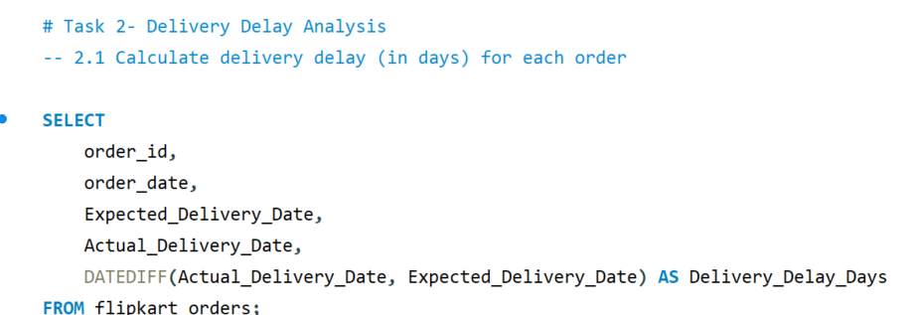
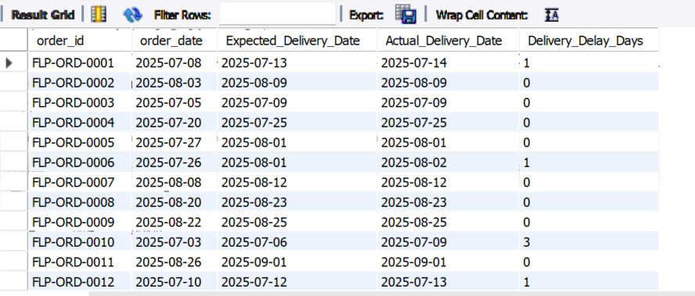
Task 2- Delivery Delay Analysis

Slide 7
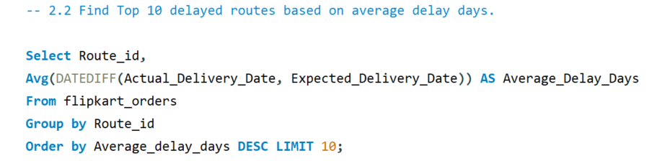
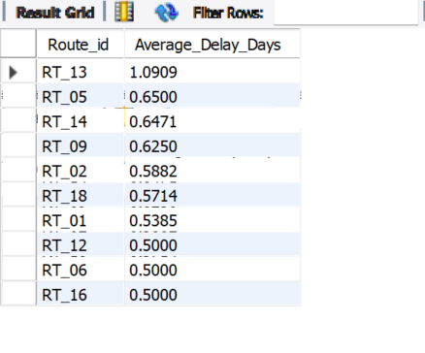
2.2: Find Top 10 delayed routes based on average delay days.

Slide 8
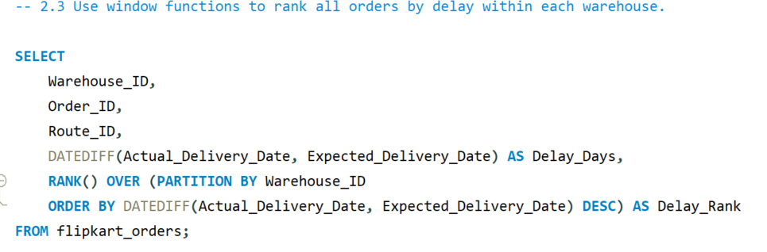
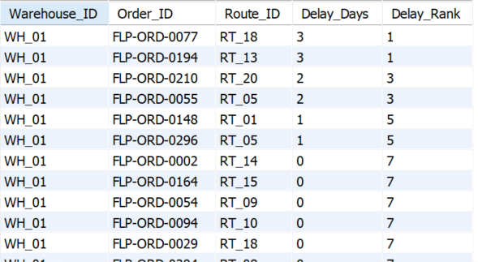
2.3: Use window functions to rank all orders by delay within each warehouse.

Slide 9
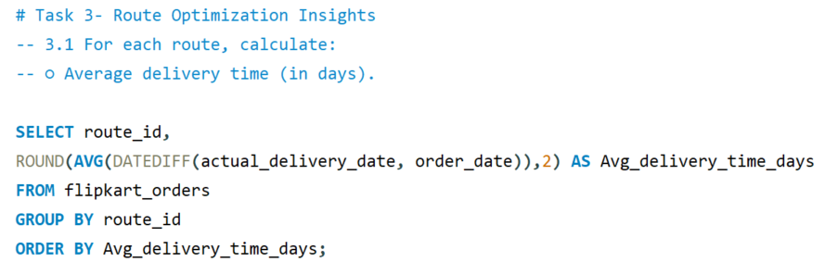
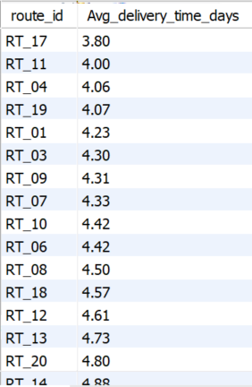
Task 3: Route Optimization Insights
3.1: AVERAGE DELIVERY TIME(IN DAYS)

Slide 10
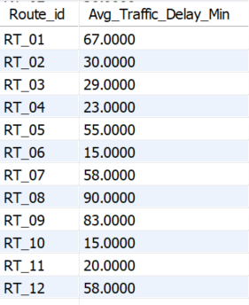
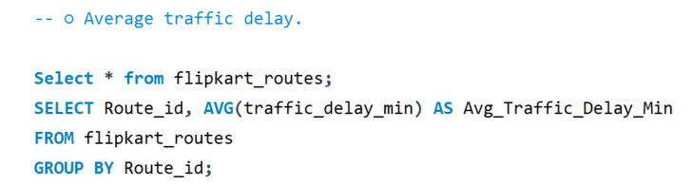
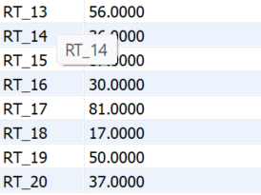
○ Average traffic delay

Slide 11
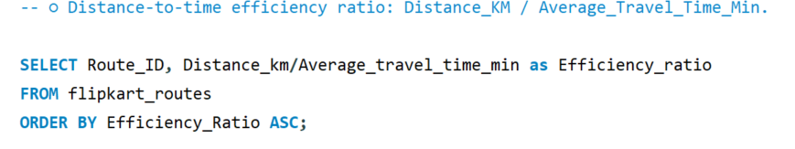
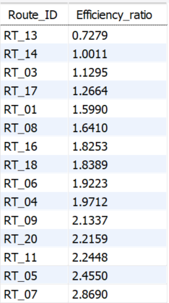
○ Distance-to-time efficiency ratio: Distance-KM / Average_Travel_Time_Min.

Slide 12
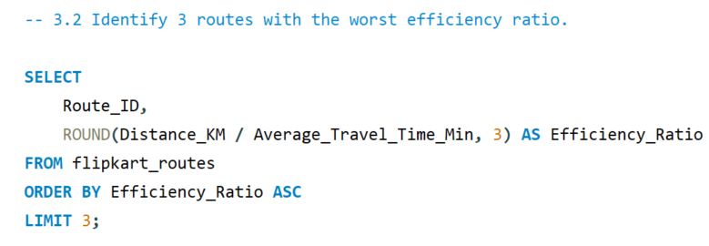
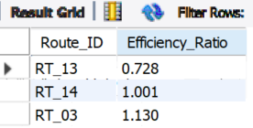
3.2: Identify 3 routes with the worst efficiency ratio

Slide 13
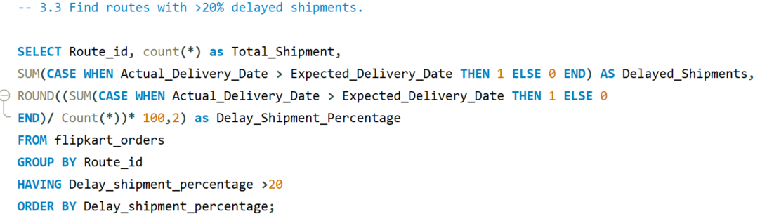
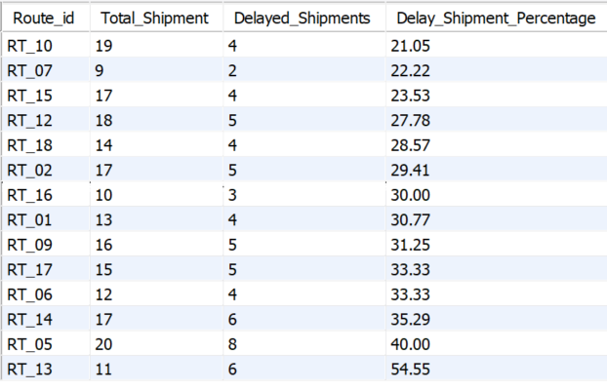
3.3: Find routes with >20% delayed shipments.

Slide 14
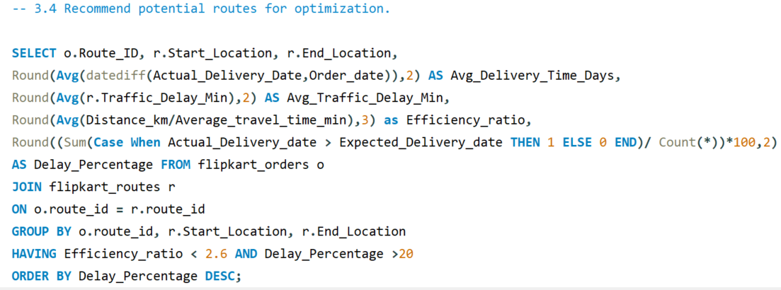
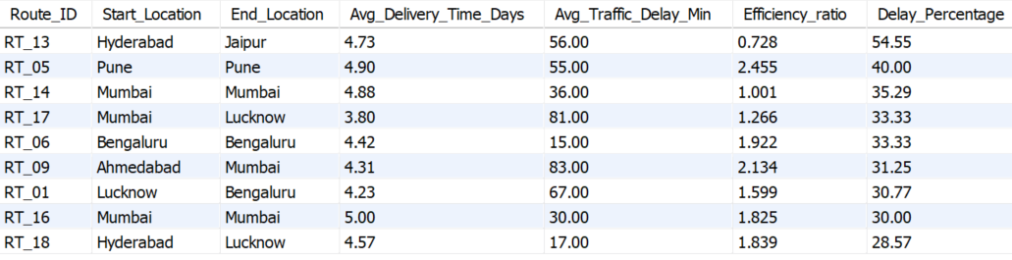
3.4: Recommend potential routes for optimization

Slide 15
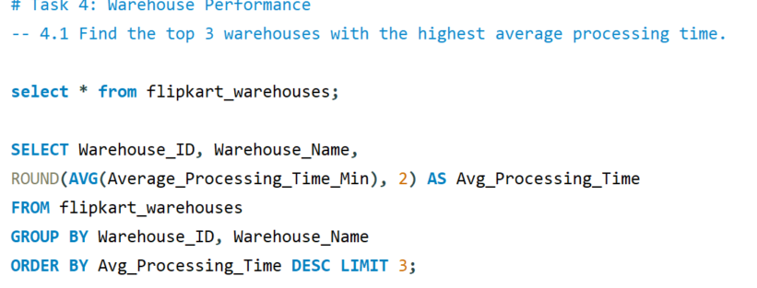
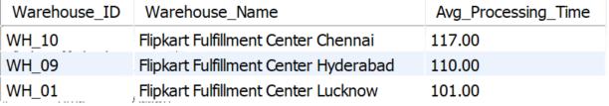
Task 4: Warehouse Performance
4.1: Find the top 3 warehouses with the highest average processing time

Slide 16
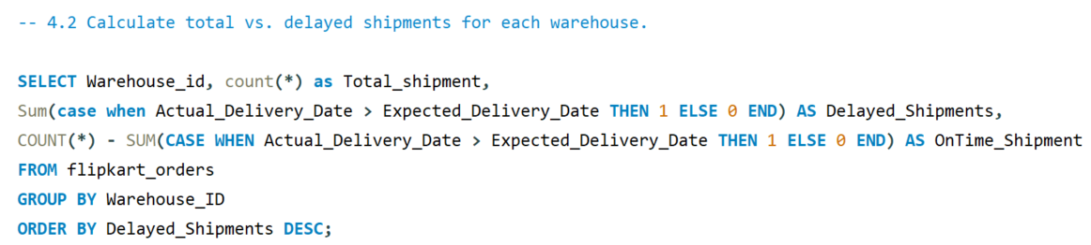
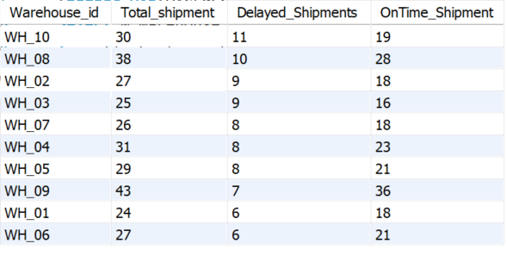
4.2: Calculate total vs. delayed shipments for each warehouse

Slide 17
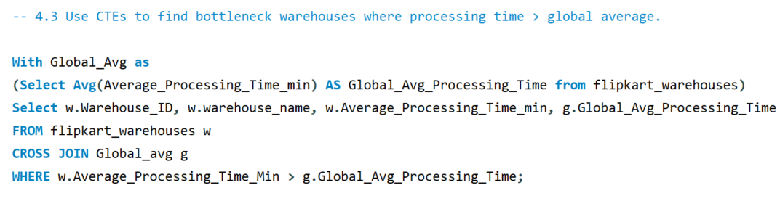
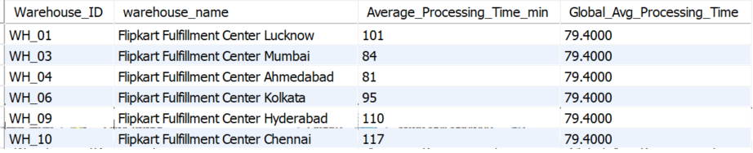
4.3: Use CTEs to find bottleneck warehouses where processing time > global average

Slide 18
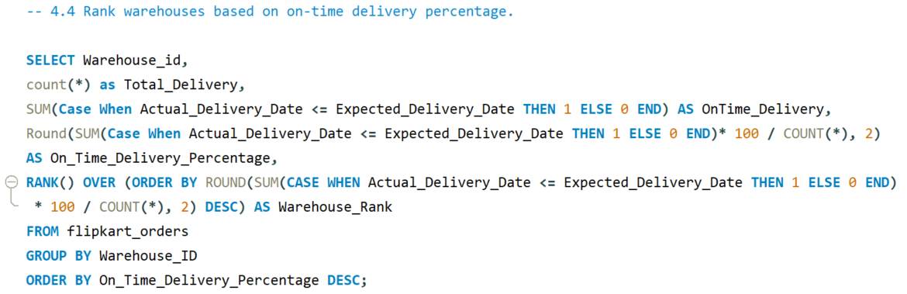
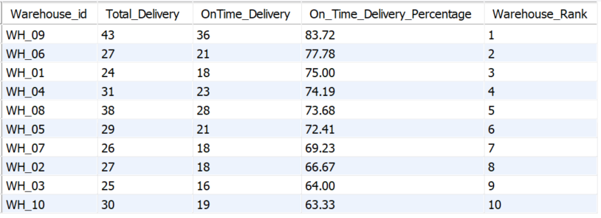
4.4: Rank warehouses based on on-time delivery percentage

Slide 19
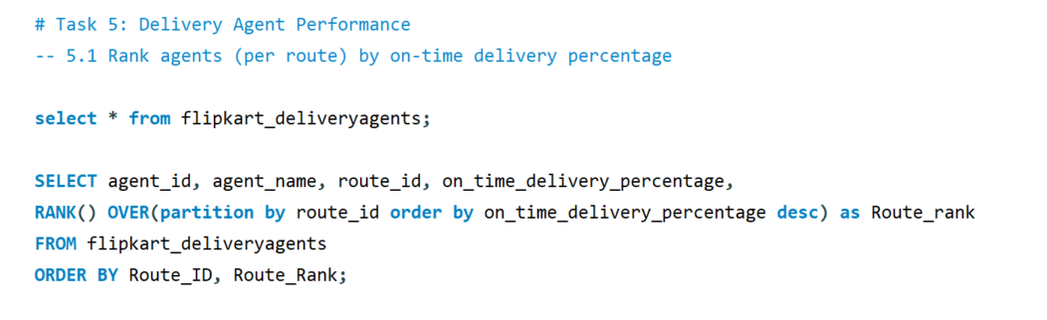
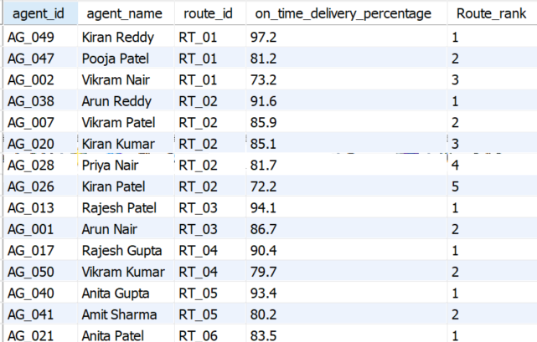
Task 5: Delivery Agent Performance
5.1: Rank agents (per route) by on-time delivery %

Slide 20
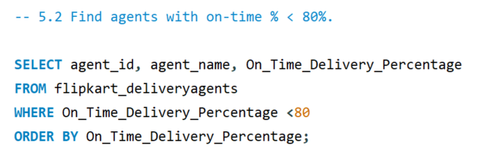
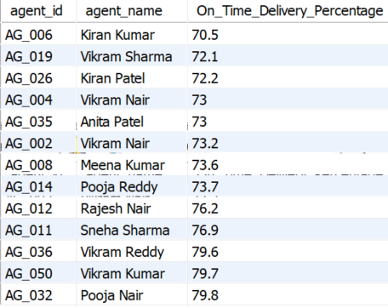
5.2: Find agents with on-time % < 80%

Slide 21
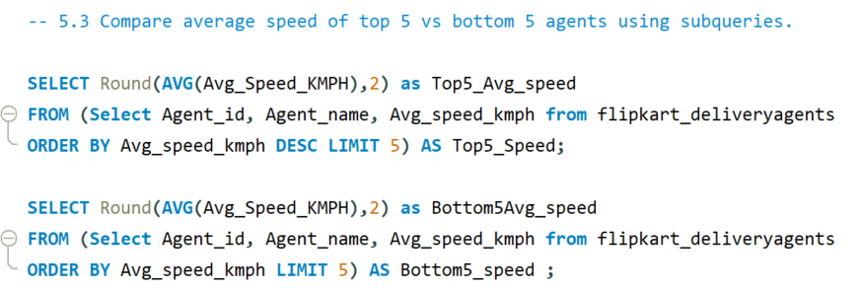
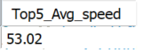
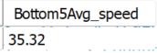
5.3: Compare average speed of top 5 vs bottom 5 agents using subqueries

Slide 22
5.4: Suggest training or workload balancing strategies for low performers
# Training Strategies:
Conduct 1-on-1 review sessions focusing on reasons for delay (traffic hotspots, route familiarity, time management).
Assign mentors from top-performing agents (on-time > 90%).
Conduct route optimization and navigation training to help agents choose faster and more efficient paths.
# Workload Balancing Strategies:
Reassign part of congested or long-distance routes from low performers to agents with higher efficiency.
Implement rotational delivery scheduling to balance workload during peak demand periods.
Distribute deliveries evenly based on agents’ average speed and years of experience to ensure fair workload.

Slide 23
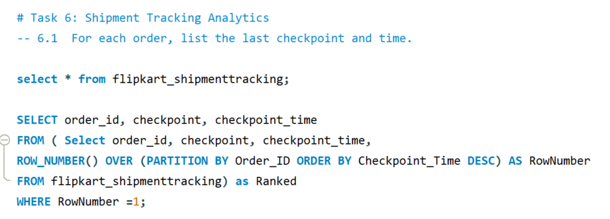
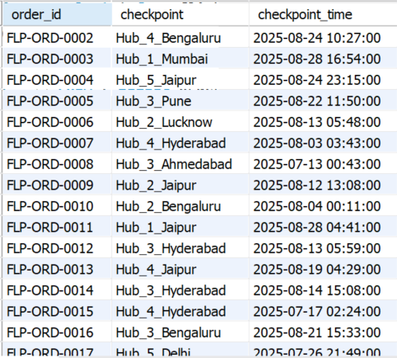
Task 6: Shipment Tracking Analytics
6.1: For each order, list the last checkpoint and time

Slide 24
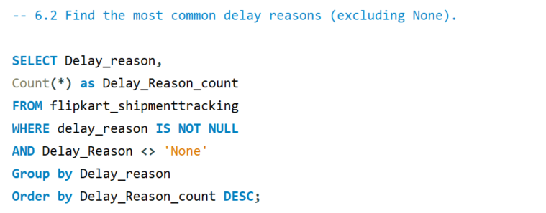
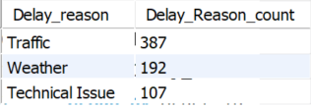
6.2: Find the most common delay reasons (excluding None)
Insights: 70% of total delay time comes from traffic congestion on urban routes.

Slide 25
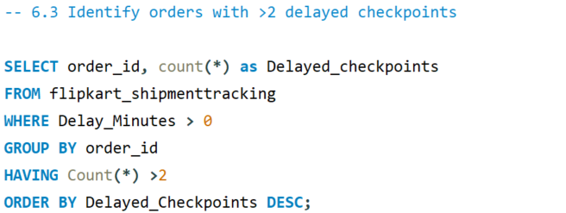
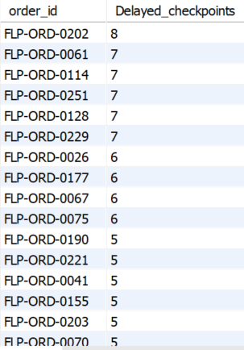
6.3: Identify orders with >2 delayed checkpoints

Slide 26
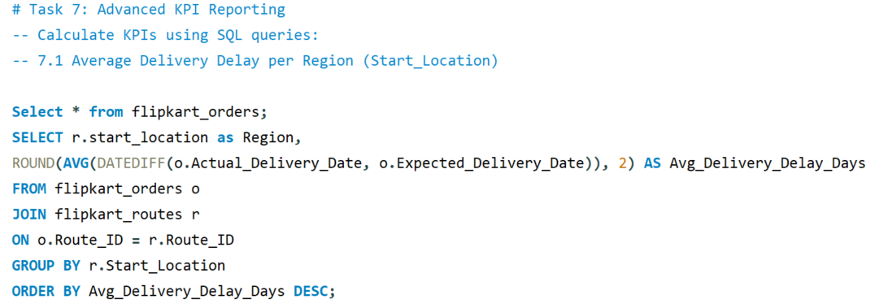
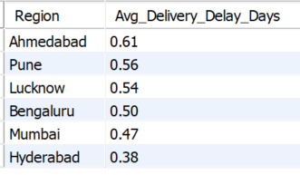
Task 7: Advanced KPI Reporting
7.1: Average Delivery Delay per Region (Start_Location)

Slide 27
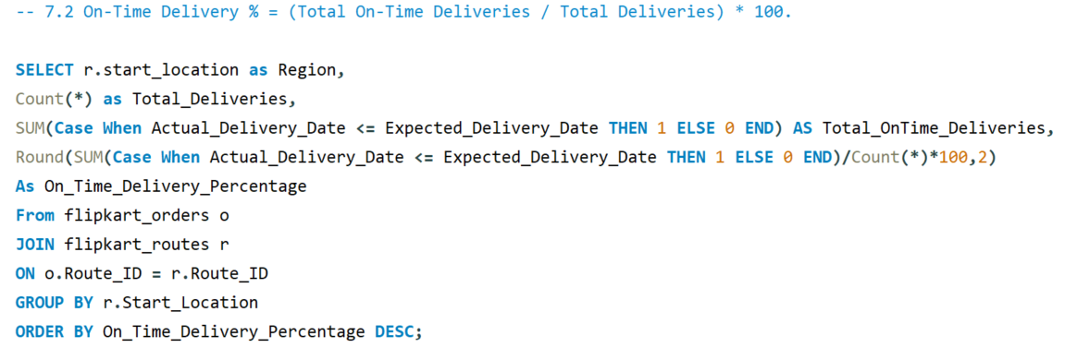

7.2: On-Time Delivery % = (Total On-Time Deliveries / Total Deliveries) * 100

Slide 28



7.3: Average Traffic Delay per Route

Slide 29



Slide 30
KPI CHARTS
INSIGHTS:
Hyderabad leads in on-time deliveries (76.13%), while Bengaluru lags at 66.67%, showing regional variation in efficiency.
High traffic delays in Pune and Lucknow (≈70 mins) strongly correlate with lower on-time performance.
Bengaluru shows low traffic delay but still moderate on-time %, suggesting internal delays.

Slide 31
KEY FINDINGS
Primary Delay Drivers- Around 70% of total delay time is due to traffic congestion, especially in urban routes like Pune and Lucknow.
Regional Performance Gaps: Hyderabad achieved the highest on-time delivery rate (≈76%), while Bengaluru lagged at ≈66%, indicating regional process inefficiencies.
Agent Performance Variance: Significant difference in average speeds between top 53.02 and low-performing agents 35.32 — suggesting the need for training and workload balancing.
Route Inefficiency : A few routes showed low distance-to-time efficiency, signaling opportunities for route re-optimization.
Warehouse Performance – Top 3 warehouses showed average processing times per minute (101-117) exceeding the global mean by 18–25%, indicating operational bottlenecks.

Slide 32
Video link
PART 1-
https://www.loom.com/share/6d3205161e0b43eda21dc63d59777a3f
PART 2-
https://www.loom.com/share/8c0a1641e3594ff987c92b714b0f0198

